Slide 1

HIT391 - Machine Learning Advancements and Applications
Lecturer (Danana): Dr. Yan Zhang
Lecturer (Sydney): Dr. Al-Amoodi Abdullah
Unit Coordinator: Dr. Yan Zhang
Faculty of Science and Technology
Charles Darwin University, NT, Australia
Email: yan.zhang@cdu.edu.au
Office: Danana Campus, Level 6, Room #9

Slide 2
Important Information
Learnline Announcement/Message section is critically important throughout.
At all times CDU student email account should be checked for updates.
If you have any issues/complaints, discuss with me first and fully understand what’s going on before deciding to take the matter elsewhere.
Please email me before visiting me in my office.
Turn around time is 2 working days for email replies. However, usually I’m much faster than that. But in case if you don’t receive any reply within 2 days then resend the email.

Slide 3
Additional Information
The lectures/tutorials will be delivered in-person both in Danana and Sydney.
Lectures will also be live-streamed Online and Recorded for later viewing. We will use Collaborate as the platform.
The recorded videos in the Collaborate may not be directly enlisted after Week 5 or 6, that doesn’t mean videos are deleted, there’s a Search feature at the top right hand corner of the Collaborate, use that with an appropeiate date range to get the earlier videos.

Slide 4
Learning Outcomes
1. Understand the general concepts and approaches used in building Machine Learning (ML) based models.
2. Critically evaluate and apply established ML based algorithms to formulate predictive models.
3. Develop an ability to critically analyse the problem domain to justify the type of ML Algorithm that needs to be used.
4. Develop sound theoretical and practical competencies in Data Analysis and Preprocessing.
5. Analyse and identify possible ethical impacts of using Machine Learning (ML) applications.

Slide 5
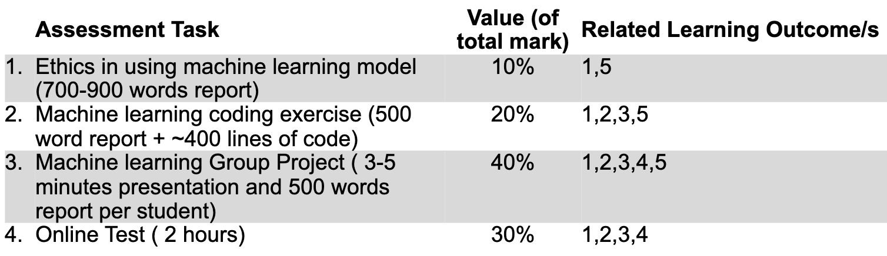
Assessment Items

Slide 6
To Study this Unit …
HIT391 is a 10 Credit points
This means that it is expected to take up 120 hours of your time over the whole semester
This averages out to 10 hours per week
Including lectures and tutorials
At least 6 hours on top of scheduled classes
You are required to
Review topics covered in lectures
Prepare for forthcoming topics and tutorials
Read reference
Complete all assessment tasks

Slide 7
Late Assessment
Late assignments will generally not be accepted.
However
Extensions may be granted prior to submission deadline in the event of demonstrated exceptional circumstances.
All applications for extensions to assignment due dates must be in writing and directed to the Unit Coordinator
Late assignments without a valid excuse will be penalised at the rate of 10% per day
Assignments will not be accepted at all after 7 days.

Slide 8
Learnline
In this unit, Learnline will be used to:
Provide important announcement about this unit.
Distribute study materials, including lecture slides.
Complete online assessments
Access feedback from tasks and grades for assessable work
Provide a communication point where you contribute to discussions as part of your assessment, and to interact with other students in the unit.
You will need to have regular and reliable broadband access to complete unit requirements.

Slide 9
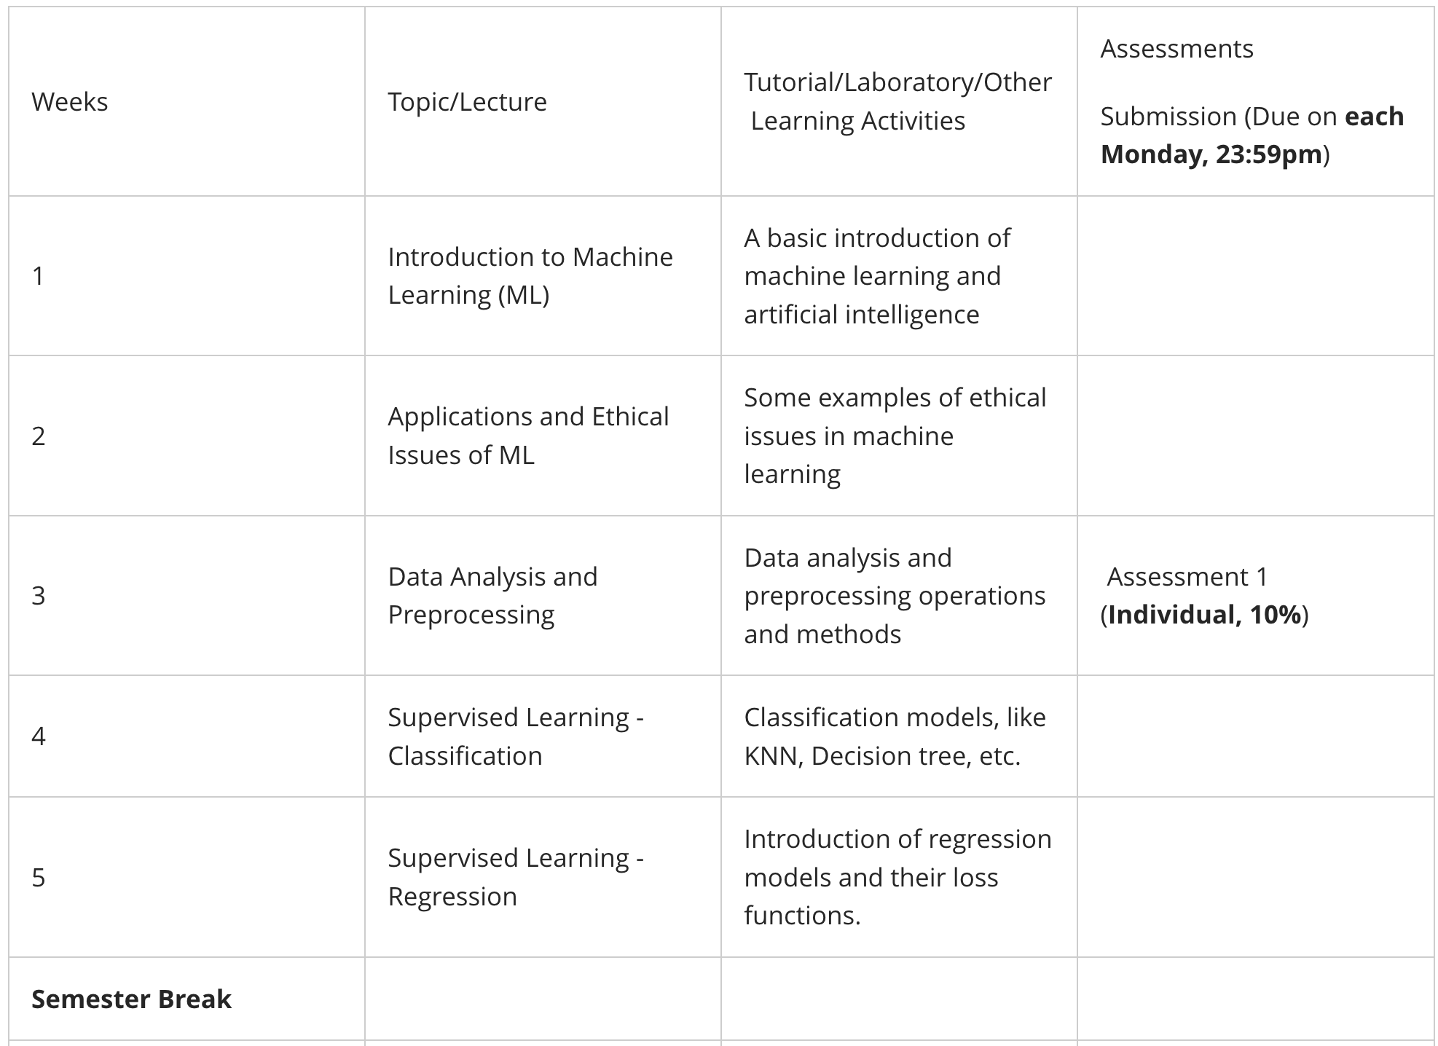
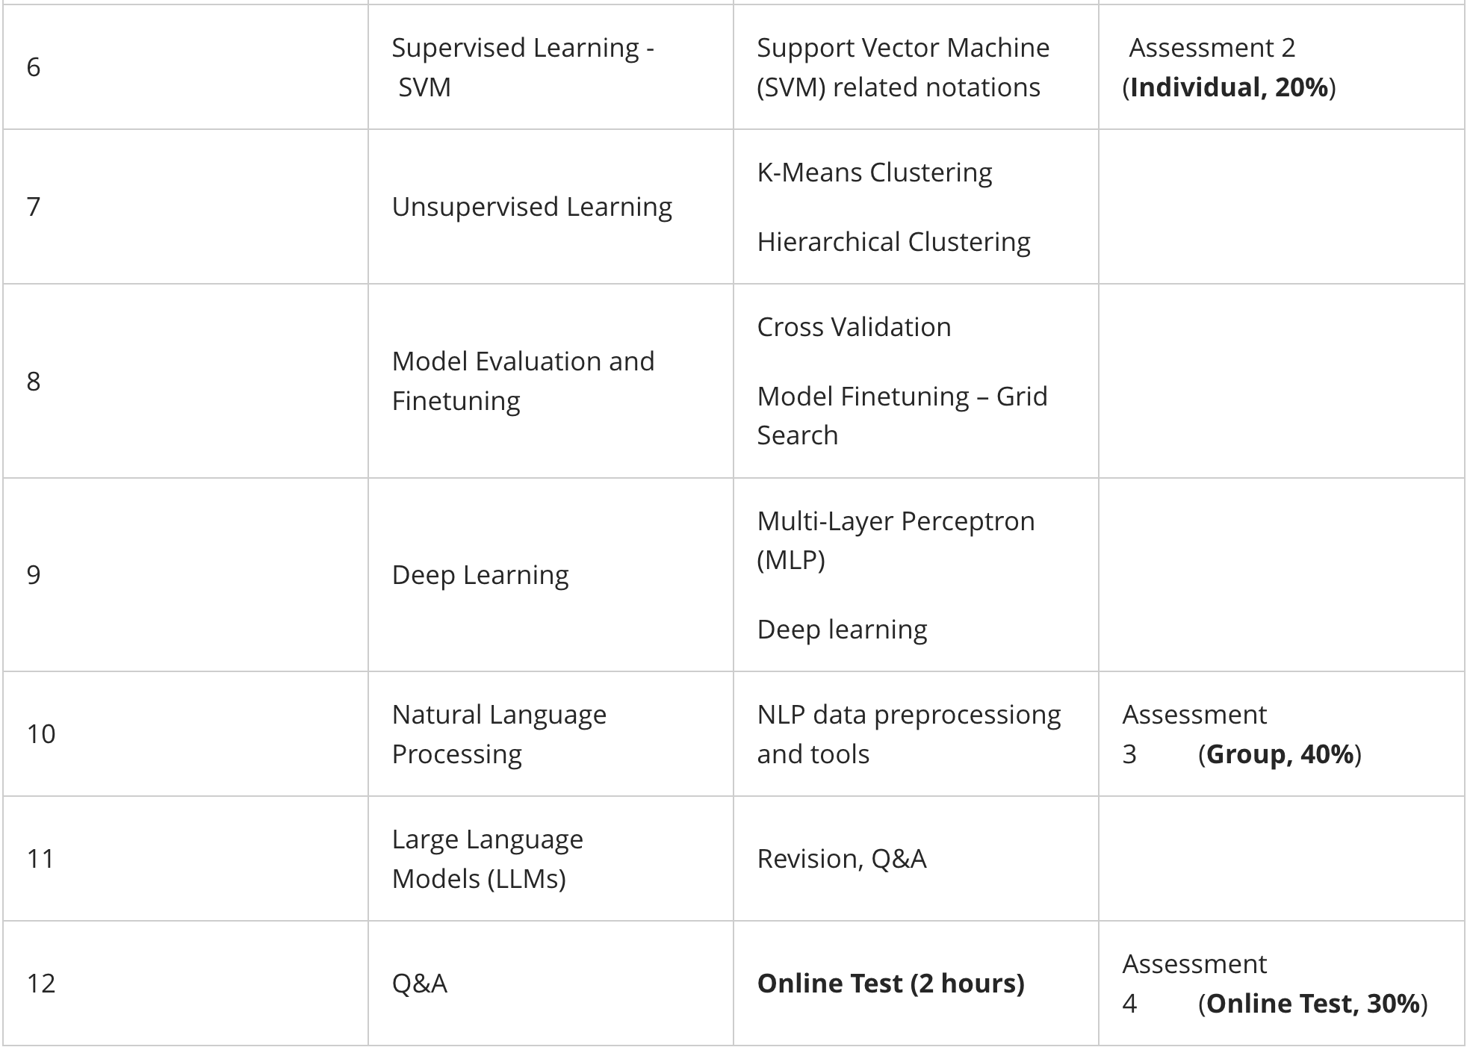
Learning Schedule

Slide 10

Resources
S. Raschka & V. Mirjalili (2019). Python Machine Learning. 3rd Edition. Packt Publishing, Mumbai.
Learning Materials Posted on Learnline Source: Weekly Tasks Panel
Lecture Videos

Slide 11
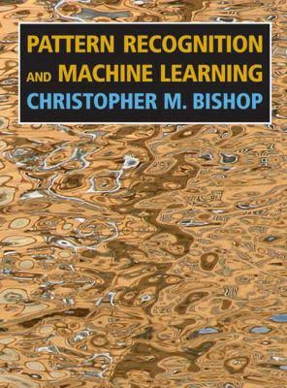
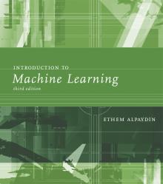

Additional Resources
Christopher M., Pattern recognition and machine learning，Bishop, Springer, 2016.
Ethem ALPAYDIN, Introduction to Machine Learning, 3rd edition. The MIT Press, 2014.
Kevin P. Murphy, Machine Learning: A Probabilistic Perspective, The MIT Press, 2012.

Slide 12
Hardware Requirements
Basic Computer Requirements:
Prerequisite – Your machine needs to have the following configuration
Your machine must meet the following specifications: Operating System: Windows 10/11 (64-bit only) RAM: 16 GB or more recommended; 8 GB is the minimum but may result in reduced performance Browser: Google Chrome or Mozilla Firefox Storage: At least 15 GB of free disk space **Note: A stable internet connection is required for installation.**

